Slide 1
Where did the Quality Principles come from and what do they mean?
Caroline Sharp
Research Director, National Foundation for Educational Research

Slide 2
Developing Quality Principles: the Story So Far
Arts Council England said all children and young people should have high quality arts experiences
We studied 31 quality frameworks from UK and internationally
We interviewed 31 people in arts and cultural organisations involved in work by, with and for children and young people
This identified 7 Quality Principles
We started The Quality Conversation
Young people responded to the Quality Principles in Newcastle, November 2012: How do we know it’s propa belta’?’

Slide 3
The Quality Principles
Striving for excellence
Emphasising authenticity
Being exciting, inspiring and engaging
Ensuring a positive, child-centred experience
Actively involving children and young people
Providing a sense of personal progression
Developing a sense of ownership and belonging.

Slide 4
1. Striving for Excellence
Having a clear vision and striving for excellence, through providing high-quality arts work and experiences, to achieve the best possible outcomes for children and young people.

Slide 5
1. Striving for Excellence
Aim to achieve the best experiences for children and young people
Innovate and take calculated risks
Aim for the best artistic quality
Expect commitment and high standards
Invest in preparation, learning, coaching and reflection

Slide 6
2. Emphasising authenticity
Offering a real and meaningful artistic experience or product, to help young people develop artistic awareness, understanding and skills.

Slide 7
2. Emphasising authenticity
Provide real experiences, not ‘surface level’ appeal or a ‘cut down’ version of something designed for adults
Set the experience in context
Develop artistic skills and understanding
Treat young people as fellow artists

Slide 8
3. Being exciting, inspiring and engaging
Being exciting and engaging, through providing inspiring and relevant opportunities that stretch, challenge and excite children and young people.
Foster positive dispositions towards the arts, and enhance their self-esteem, wider aspirations and life choices.

Slide 9
3. Being exciting, inspiring and engaging
Chose themes that excite and inspire
Ensure work is relevant to children and young people
Aim to have an impact on young people now and in the future
Challenge young people to take on new ideas

Slide 10
4. Ensuring a positive, child-centred experience
Ensuring a positive, child-centred experience for all through having the passion, commitment, knowledge and skills for work involving children and young people, helping them to develop as confident individuals and celebrate their achievements.
This includes encouraging individual contributions and valuing diversity.

Slide 11
4. Ensuring a positive, child-centred experience
Adults who are passionate about working with children and young people and who have the right skills
Clear, honest communication and flexibility
Working alongside, sharing skills
Valuing individuals, encouraging young people from different backgrounds and with different needs
Make it OK to be different

Slide 12
5. Actively involving children and young people
Emphasising the active involvement of children and young people, through interactive opportunities – hands-on participation and collaboration – to develop children and young people’s skills and creativity.

Slide 13
5. Actively involving children and young people
Actively engage young audiences
Hands-on involvement
Direct collaboration

Slide 14
6. Providing a sense of personal progression
Taking account of children and young people’s individual needs, through recognising their different starting points, experiences and achievements; enabling them to achieve their potential, and progress on to next steps in their learning and achievement.

Slide 15
6. Providing a sense of personal progression
Find out what a young person can do and what interests them
Consider what they might want to do next
Make connections and referrals

Slide 16
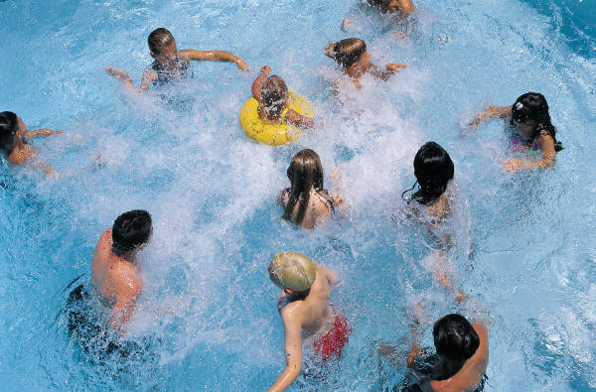
7. Developing a sense of ownership and belonging
Focusing on children and young people’s sense of ownership and belonging, so that young people can make an informed judgement about ‘this is, or could be, or isn’t for me’.

Slide 17
7. Developing a sense of ownership and belonging
Encourage choice, autonomy, decision-making and creative responses
Provide opportunities for children and young people to take the lead and set the direction
Welcome children and young people
Help them feel part of the family

Slide 18
Creative challenges: responding to feedback from young people
Do we need to clarify the meaning of excellence/quality in Principle 1 (Striving for Excellence)?
Principle 2: ‘Authenticity’ was not clear to young people – do we need to call it something else?
Principle 5: what does ‘active involvement’ mean in work for children and young people?
Principle 7: Would it be better to say: ‘Ensure children and young people belong and that the experience belongs to them’? How would ‘ownership’ work for younger children?

Slide 19
Creative challenges: next steps
How would you like to see these principles used in future?
How will we know if better quality is achieved as a result?

